Slide 1


Police Department Incident Reports: San Francisco

Slide 2

Introduction to the dataset
The dataset is a collection of police department incident reports in San Francisco. It includes information on the type and location of incidents, as well as the date and time they occurred.

Slide 3



Types of incidents
The most common type of incident was Larceny/Theft.
The second most common type of incident was Non-Criminal.
The third most common type of incident was Assault.

Slide 4
Types of incidents
Top 10 Incident Categories:
Larceny Theft 195029
Other Miscellaneous 48999
Malicious Mischief 45627
Assault 42733
Non-Criminal 41283
Burglary 39249
Motor Vehicle Theft 35470
Fraud 22050
Warrant 20185
Recovered Vehicle 19871

Slide 5
Analysis on Heinous Crimes
I Selected 10 Categories which are classified as Heinous crime due to its nature of severity.
Which Includes: 'Homicide', 'Rape', 'Arson', 'Fraud', 'Drug Offense', 'Robbery', 'Missing Person', 'Sex Offense', 'Prostitution’, and 'Human Trafficking (A), Commercial Sex Acts’.

Slide 6
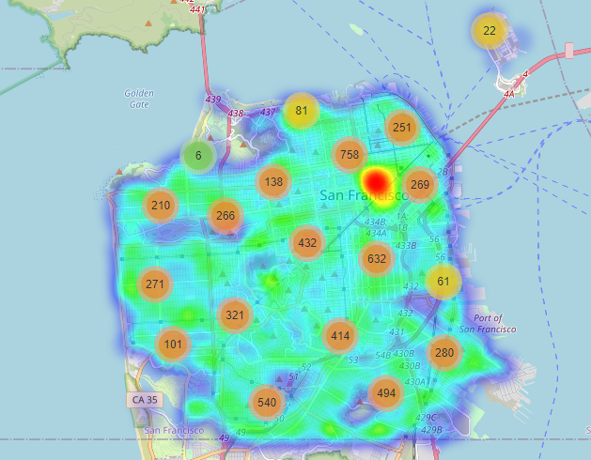
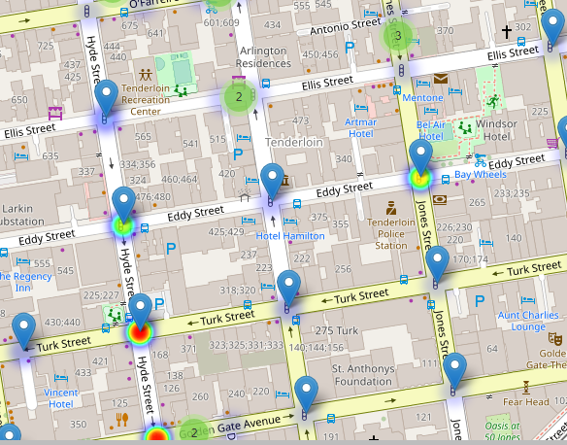
Map
Map showing red spot indicates highest number of heinous incidents reported in Neighborhood of Tenderloin.

Slide 7
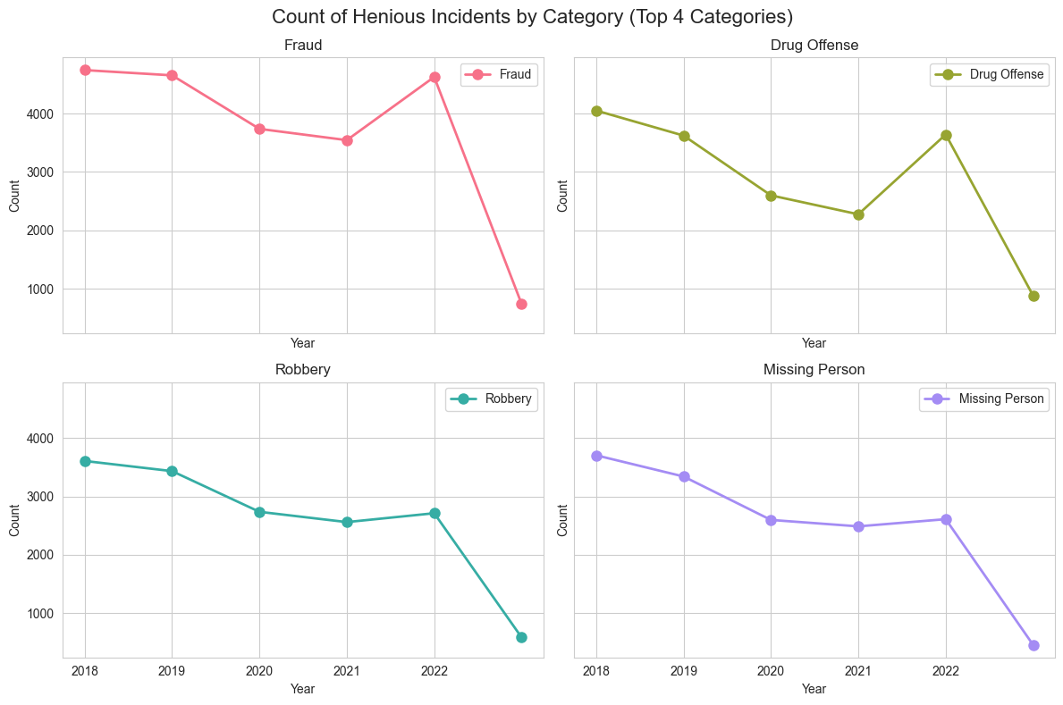

Slide 8
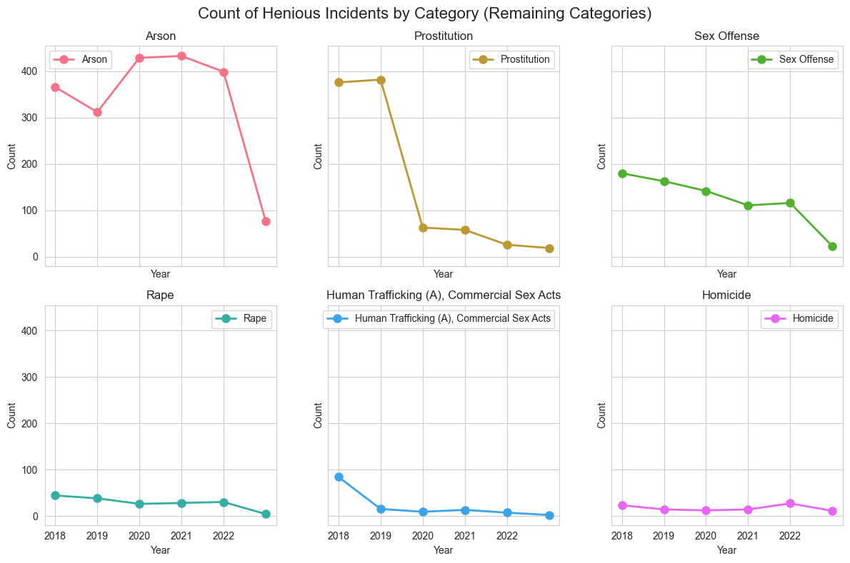

Slide 9
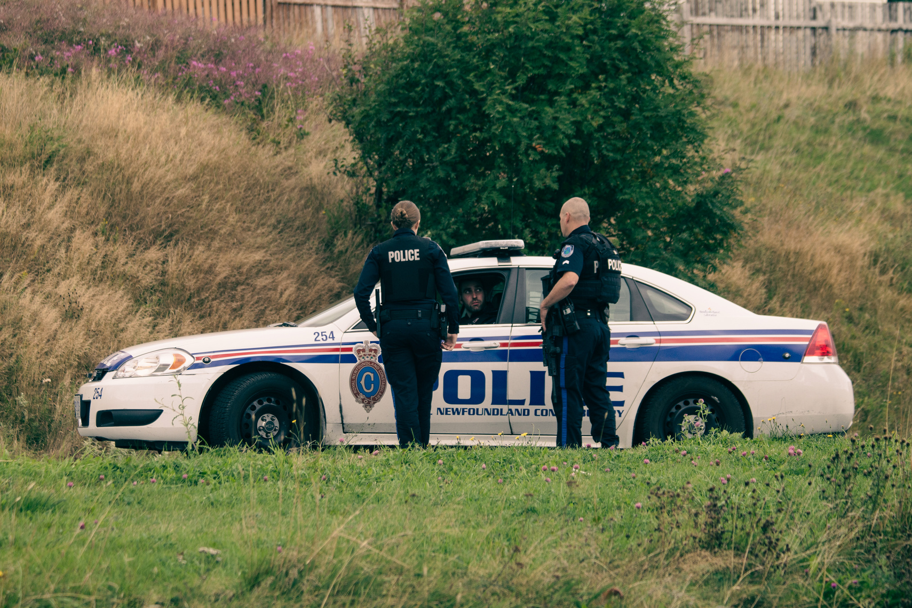
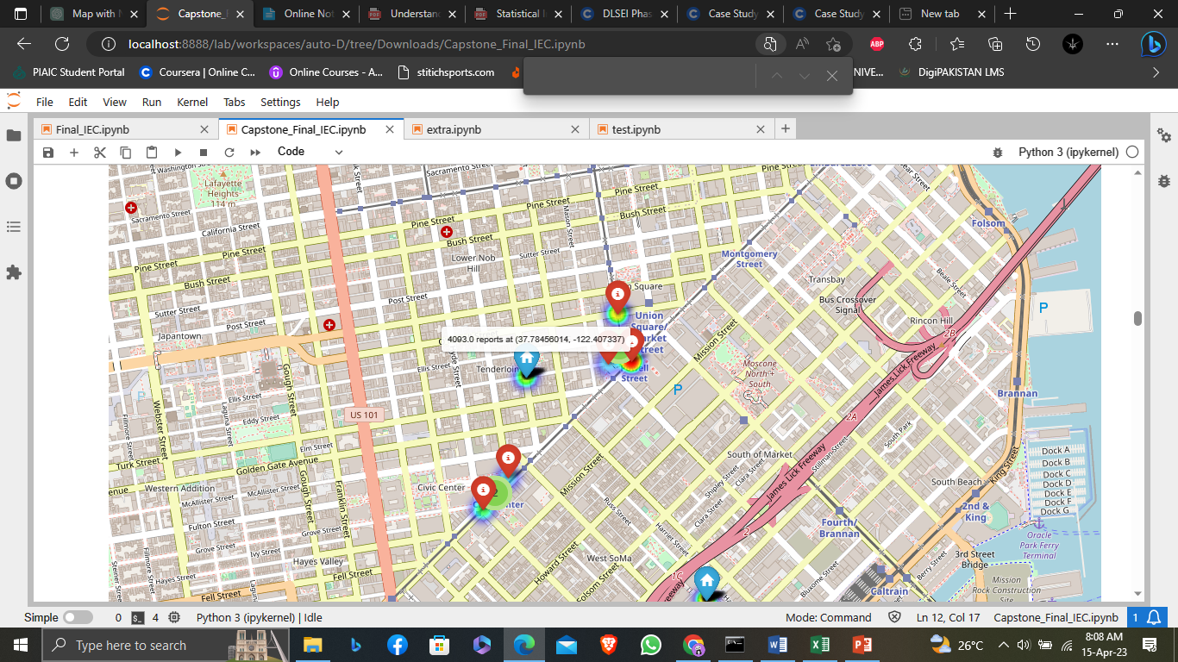
Locations of incidents
The majority of incidents occurred in the Mission.
The second highest district for incidents was the Tenderloin.
The McLaren Park district had the fewest incidents reported.

Slide 10
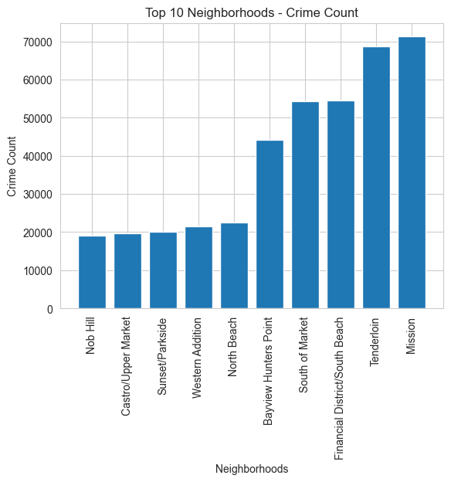
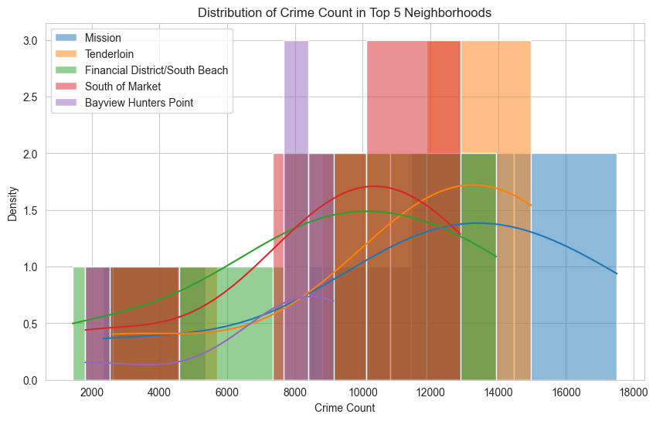
Locations of incidents

Slide 11
Locations of incidents
Hypothesis Testing to see if there significant difference between Incident Count of Top 2 Neighborhood.
Neighborhood A: Mission
Neighborhood B: Tenderloin
T-statistic: 0.14709620307510143
P-value: 0.8860259984216026
Fail to reject the null hypothesis. There is no significant difference in crime rates between the top 2 neighborhoods.

Slide 12


Analysis of incidents by time of day
Analyzing incident reports by time of day can reveal important crime rate trends. This information can inform police strategy and resource allocation.
In my observation. I found that peak time in which most incident occurs is at day 12 pm and in night 12am.

Slide 13


Analysis of incidents by day of week
Analyzing incident reports by day of week can help detect patterns and improve resource allocation. There is no significant difference between different days for incident occurrence buy day-wise most occurrence are on Friday.

Slide 14



Analysis of incidents by month of year
Analyzing incident reports in San Francisco by month of year reveals patterns and trends in crime. Use data to inform prevention strategies. Most incident are reported in the month of January.

Slide 15
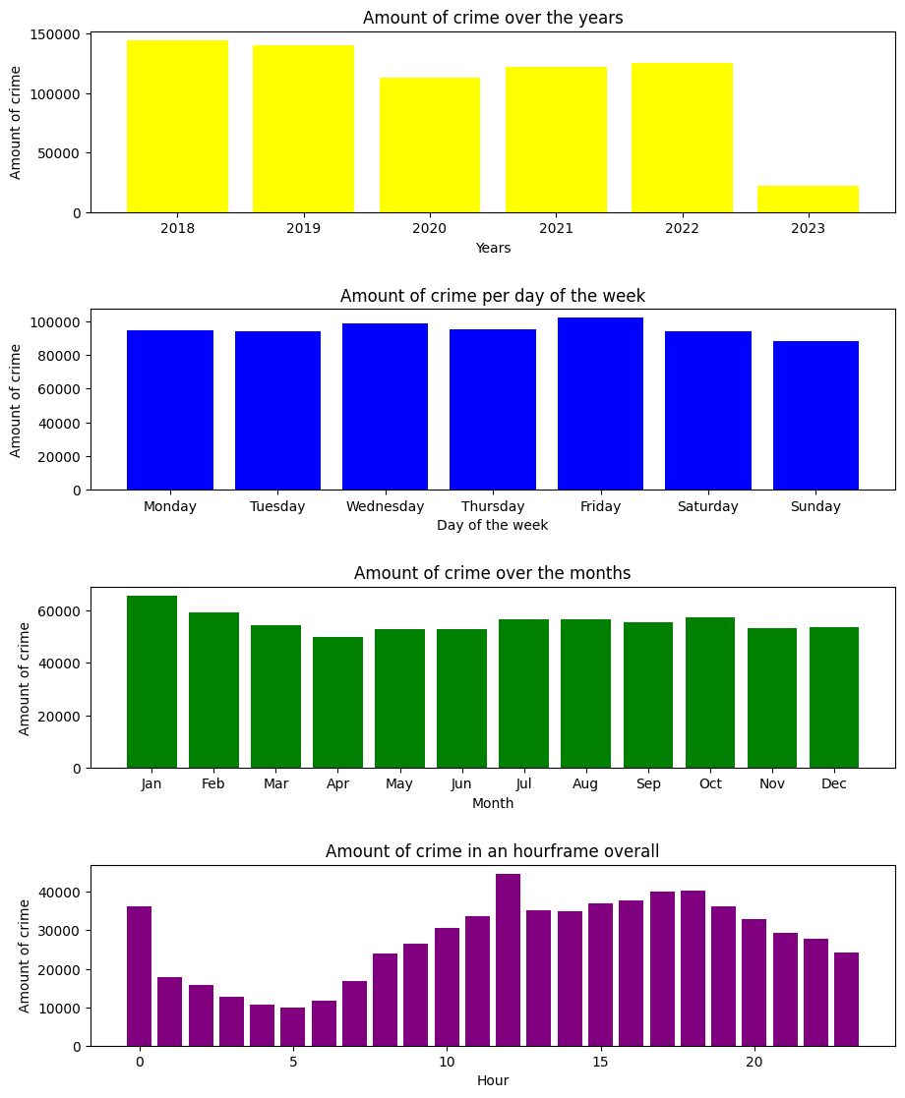

Slide 16
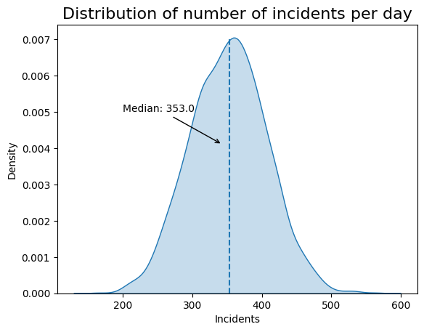
Graph shows that 353 incident occurs per day overall.

Slide 17

Resolutions for All Incident Categories
Resolutions have following categories (Along with %):
Open or Active 0.791195
Cite or Arrest Adult 0.200483
Unfounded 0.005582
Exceptional Adult 0.002741
Most of the Cases are still unsolved as we can see. Around 79%.
Percentage of Solved cases is only 20%.
Percentage of Solved cases is only 20%.

Slide 18
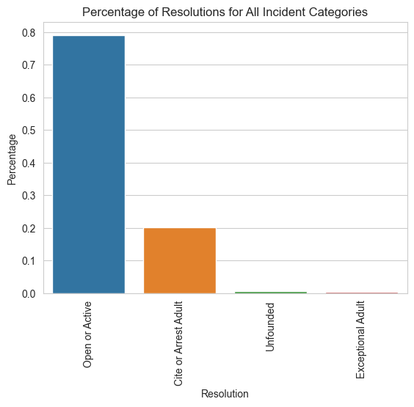
Resolutions for All Incident Categories
Percentage of Solved cases is only 20%.

Slide 19


Further Analysis
Cross-tabulation analysis between Incident Category and Report Type Code/ Report filed online or not.
Hypothesis testing to see significance difference between response time in weekdays and weekend.
Try to find correlation between increase in crime and socio-economic factor such as income, education, and employment rates.
See any correlation between
Columns: 'Longitude', 'Latitude', and 'Supervisor District' using correlation matrix.

Slide 20
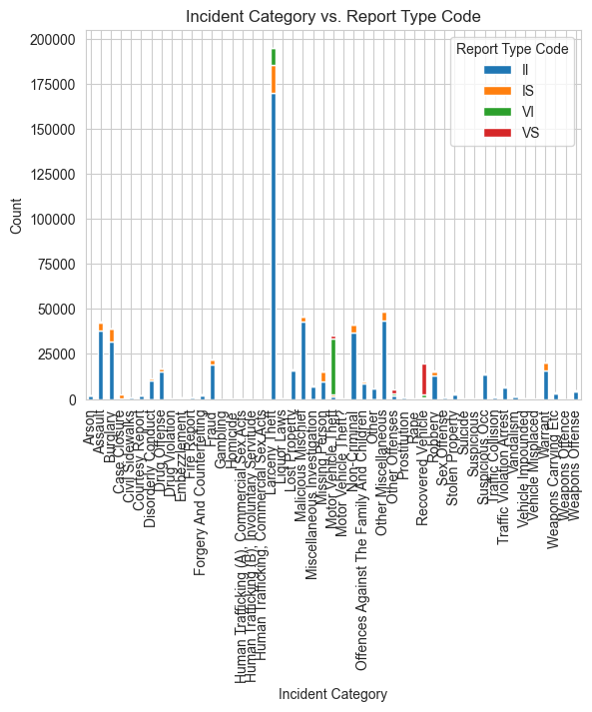
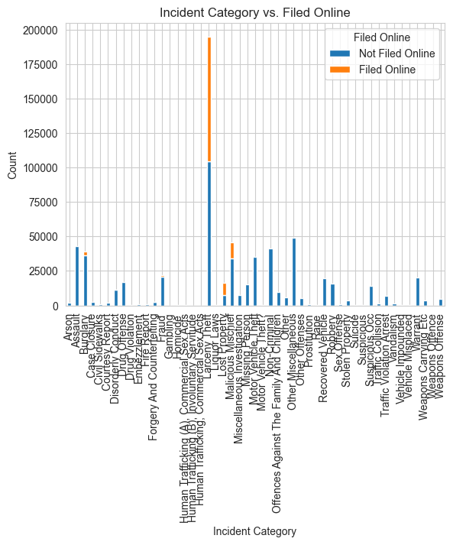
Further Analysis
Fig1 indicates most type of incident falls in Report type initial and Fig2 indicates that crimes are mostly not filed online.

Slide 21
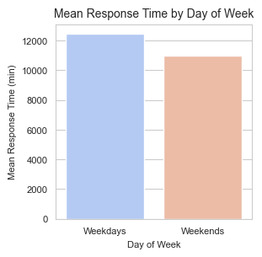
Further Analysis
Hypothesis testing to see significant difference in response times between weekdays and weekends.
Weekdays Mean Response Time (min): 12480.21956662528
Weekends Mean Response Time (min): 10993.759766600613
T-statistic: 6.549474025843093
P-value: 5.778175404024408e-11
Null hypothesis rejected. There is a significant difference in response times between weekdays and weekends.

Slide 22
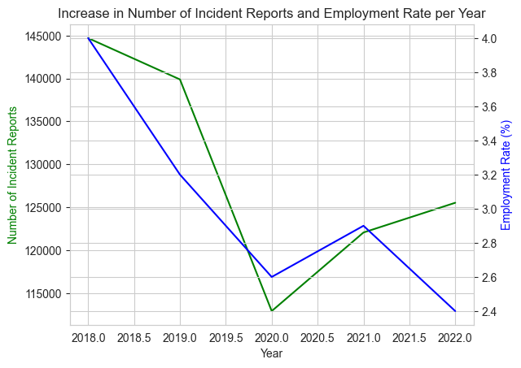
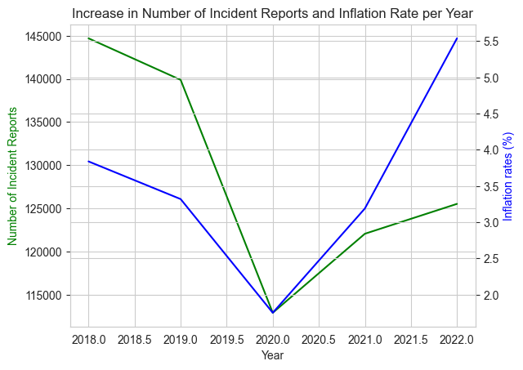
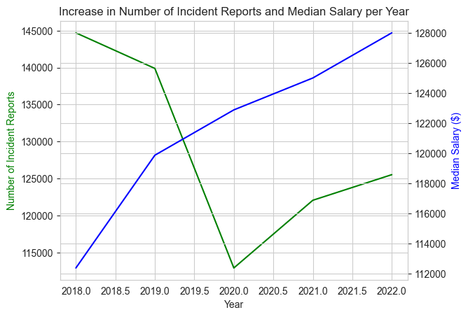
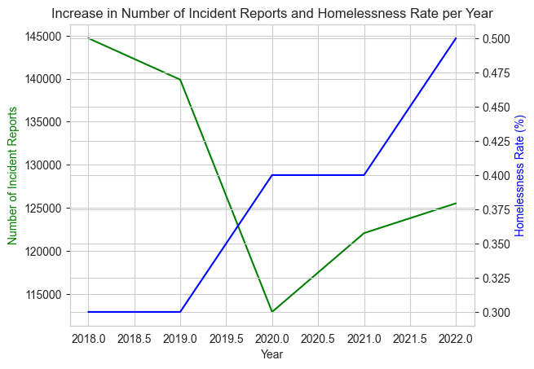
Further Analysis
Relationship between Inflation and increase in crime rate seems to be linear also iwe can see some relevance between incident reports and Homelessness rate while others don’t show significant relation.

Slide 23
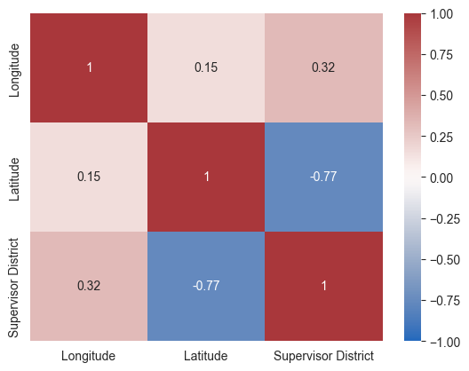
Further Analysis
Fig shows correlation between Columns: Longitude, Latitude and Supervisor District using correlation matrix and we can see some weak linear relationships between Longitude and Latitude, as well as Longitude and Supervisor District. However, there appears to be a stronger negative linear relationship between Latitude and Supervisor District.

Slide 24
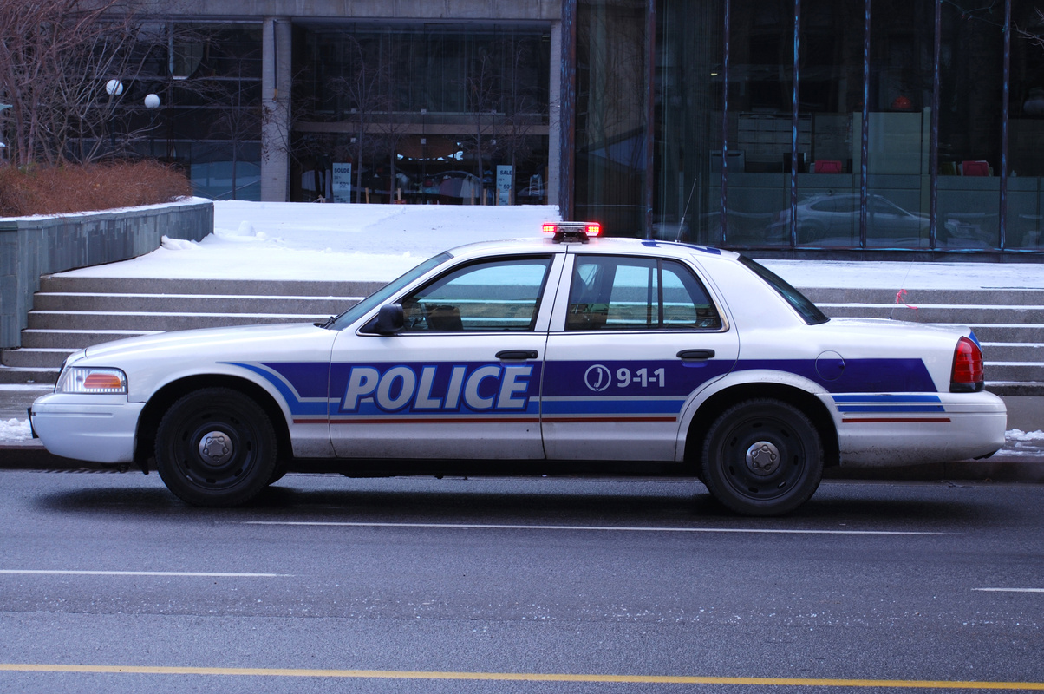

Conclusion and recommendations for the police department.
To improve incident response times specially in weekends and put take extra measure in the month of January as it has highest rate months-vise, increase police presence in high-crime areas such as Mission and Tenderloin. Improve the rate of incident resolution as 20% rate is too low. For Government it should take serious measure to decrease Homelessness rate and inflation as it encourages petty crimes.

